Slide 1



Slide 2
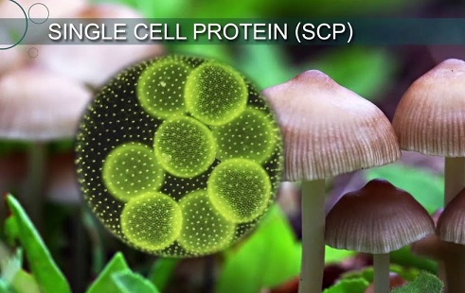
Presented By :-
GAURAV PRADIPRAO
KUKADE

Slide 3
SYNOPSIS
What is SCP
Source of SCP
Production of SCP
Advantage of SCP
Disadvantage of SCP
Application of SCP

Slide 4
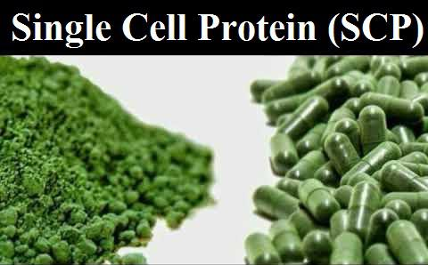
What is Single Cell Protein -SCP? Single-cell protein refers to the crude, a refined or edible protein extracted from pure microbial cultures, dead, or dried cell biomass. They can be used as a protein supplement for both humans or animals. Microorganisms like algae, fungi, yeast, and bacteria have very high protein content in their biomass. These microbes can be grown using inexpensive substrates like agricultural waste viz. wood shavings, sawdust, corn cobs etc. and even human and animal waste.

Slide 5
Sources of Single Cell Protein A list of the microorganisms used for the production of Single Cell Protein is as follows: Fungi Aspergillus fumigatus Aspergillus niger Rhizopus cyclopean Yeast Saccharomyces cerevisiae Candida tropicalis Candida utilis Algae Spirulina (spa) Chlorella pyrenoidosa Chondrus crispus

Slide 6
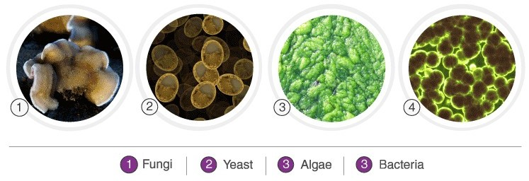
Bacteria Pseudomonas fluorescens Lactobacillus Bacillus megaterium

Slide 7
Here are the average compositions of the different microorganisms present in the % dry weight of Single-cell protein.
Composition | Fungi | Algae | Yeast | Bacteria
Protein | 30-45 | 40-60 | 45-55 | 50-65
Fat | 2-8 | 7-20 | 2-6 | 1-3
Ash | 9-14 | 8-10 | 2-6 | 3-7
Nucleic Acid | 7-10 | 3-8 | 6-12 | 8-12

Slide 8
Production of Single-Cell Protein The production is carried out in the following steps: Selection of suitable strain. Fermentation. Harvesting. Post-harvest treatment. SCP processing for food. Like any other microbial culture, production of pure microbial cultures for desired protein products requires a nitrogen source, sources of carbohydrates and other nutrients like phosphorus to support optimal growth of the culture. Contamination is prevented by maintaining strict sterile conditions throughout the process. The components of the culture media are either heat sterilized or filtered through microporous membranes. The selected microorganism is then inoculated in pure conditions. Most of the processes are highly aerobic, except algal fermentation; hence a good supply of oxygen is an indispensable requirement. After the multiplication of the biomass, it is recovered from the medium and purified further for enhanced usefulness and or storability.

Slide 9
Advantages of Single-Cell Protein Large-scale Single-Cell Protein production has multiple advantages over conventional food production practices such as: Microorganisms have a high rate of multiplication, which means a large quantity of biomass can be produced in a comparatively shorter duration. The microbes can be easily genetically modified to vary the amino acid composition. A broad variety of raw materials, including waste materials, can be used as a substrate. This also helps in decreasing the number of pollutants. Production is independent of climatic conditions.

Slide 10
Disadvantages of Single-Cell Protein In spite of many advantages, there are few drawbacks. Single-Cell Protein has not been widely accepted for human consumption owing to certain problems as follows: High level of nucleic acid in biomass makes it difficult for consumption as it may lead to gastrointestinal problems. The biomass may trigger an allergic reaction if the digestive system recognizes it as a foreign product. The presence of nucleic acids in high content leads to elevated levels of uric acid. In certain cases, the development of kidney stone and gout if consumed in high quality. Possibility of the presence of secondary toxic metabolites which results in Hypersensitivity and other skin reactions. The capital cost of production is high as sophisticated machinery is required.

Slide 11
Applications of Single-Cell Protein Provides instant energy. It is extremely good for healthy eyes and skin. Provides the best protein supplemented food for undernourished children. Serves as a good source of vitamins, amino acids, minerals, crude fibres, etc. Used in therapeutic and natural medicines for: Controlling obesity. Lowers blood sugar level in diabetic patients. Reducing body weight, cholesterol and stress. Prevents accumulation of cholesterol in the body. Used in Cosmetics products for: Maintaining healthy hair. Production of different herbal beauty products, like- Biolipstics, herbal face cream, etc.

